Slide 1

Operator-Framework Workshop
A Tour of the OperatorSDK
Notes:
so we're going to do a tour of operator SDK so we've talked about a lot of tooling controller-gen for example that is going to help us build like CRDS and also does other things that we didn't really cover it helps us build rbac as well so we don't have to manage those things let's talk about what operator sdk offers us in terms of functionality if we're trying to get an operator written

Slide 2
Key Topics
Building an operator from scratch
Planning our operator, what it takes to build it from scratch.
Taking advantage of operator development tools
Making things easier using the OperatorSDK project.
Exploring the controller-runtime
Working with the reconcile.
Notes:
we're going to cover you know what it takes to build an operator from scratch you know taking advantage of these tools and then of course exploring the controller runtime controller runtime is a library that is written in go and is available to us to help really ease the process of writing a scalable and best practice operator right it's made available by kubernetes API machinery sig

Slide 3
Building operators from scratch

Slide 4
We need to… (at a high level)
Have a working client to talk to the Kubernetes API!
Watch the API for changes to our primary resource (“CustomApp”, “Etcd”, etc.).
Watch the API to see if our secondary resources (pods, deployments, etc.).
Use a client to get a current state of the resources my operator manages.
Determine if the current state matches the desired state. Otherwise make it so.
Set up Eventers so that we can emit Kubernetes Events when things change (help the cluster administrators see what’s happening).
Update the primary resource’s status block to give users insights into what’s happening.
Notes:
as far as building operators from scratch and we're going to just rush through this right here because this is more just enforcing the concept but we you know we have to do we have a lot of things we have to have code that is functioning as a working client we need to talk to the kubernetes API right 'cause we need to be able to check to see if we can if we can pull a particular resource or custom resource or maybe we want to deployments whatever right we need a client that works we’ll need to watch the API for changes right to primary resources this primary resource concept term is a thing that I don't think we've mentioned maybe we have but it is your custom resource right that is a custom app or the etcds in our previous examples right we're going to use that same client to watch for secondary resources so say custom app deploys three pods as an example maybe a database web tier middleware or whatever right those are secondary resources we need to also watch for those because what happens if a user changes our pods from underneath us well we want the controller go and fix that right and make it the declared state according to custom app and we build relationships with those using our owner references which we've talked about previously and then we're going to use that client to get the current state of the resources my operator manages so we've already talked about the primary resource the secondary resource as well we need to get the current state and then in our code we need to determine if the current state matches the desired state so what does that mean right if a custom app is my primary resource well it creates three pods that's what my thing my reconciler is doing my operator is doing that exactly as we saw in the argosy demo we created an Argo CD and it created five deployments right five different workloads well I need to go see if every time the deployment changes I need to go check to see the current state of my Argo CD and I need to you know if it has changed make changes to those deployments to make it so and so we also will have to do that that's a core piece of our reconciliation and then let's say that we want to do we want to admit Kubernetes events right we know what rudy's events are if we do OC get events we get a lot of notifications associated with a given resource or I think if you do the describe OC describe a deployment you'll see events there as well as well as other things like the status conditions etc etc so we've got to set up an event are we've got to hook into the event system such that whenever we are creating maybe we're creating a deployment we emit an event say hey we changed this deployment or we created this appointment right and then we need a status writer right it's part of our client we need to be able to talk to the API to write to our custom app status right we talked about how if you use a custom app or use a deployment there is a status block the custom resource definition is a status block that tells us what the controller says it has done with that particular instance of that resource

Slide 5
What about from the administrative side?
Our controller runs IN a Kubernetes cluster, so what about:
Roles and Cluster Roles for any API resources we need to access?
RoleBindings and ClusterRoleBindings?
The Service account?
The deployment manifest for our controller manager?
Notes:
and then from an administrative side right we've got all of these things we've got it's going to run increase cluster we've talked about how it's going to need rolls we saw that with etcd that before we even installed an etcd instance we had roles and role bindings and maybe cluster roles depending on what you need right we had a service account so who created that service account we've got to have that there so those are all things that are go included in our project and then the deployment manifest for our controller manager right because we saw the etcd when we installed it the operator had a deployment specification right that whole manifest there we have to write that down so that we can then feed it to an administrator like a person that is going to install it in our cluster or sorry or well that all them will go install that for us as well so we need to have those assets built out so that we can provide to those people or those softwares to go and install in our cluster

Slide 6
In Summary
Getting started from scratch is a ton of work.
Notes:
so getting from getting started from scratch is a ton of work right it's absolutely we even just writing the custom resource definition we saw how much code we had to write

Slide 7
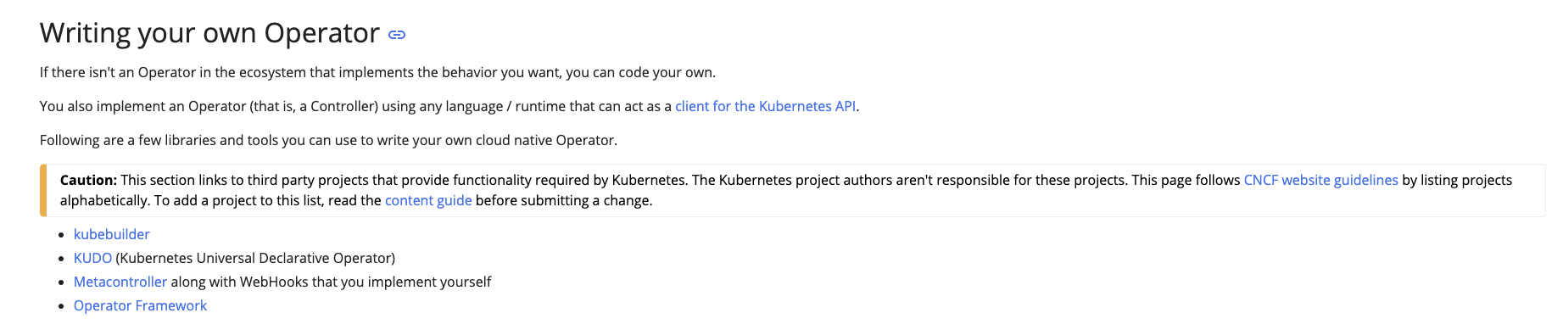
In Summary
There are tools to help.
Getting started from scratch is a ton of work.
https://kubernetes.io/docs/concepts/extend-kubernetes/operator/
Notes:
and so in summary there are tools of course to help obviously right otherwise you know this would be a very difficult process and probably wouldn't be as widely adopted and so this is straight from the create documentation you see here kubebuilder kudo metacontroller and operator framework those are all options that are there to help users get a controller written for deployment there an operator written and so there are tons of tools aside from these are all using probably libraries underneath to help build the different things that you need clients informers caches all this kind of stuff and so there are tons of tools to help but of course that will help make this easier

Slide 8
Tools makes it easier.
We’ll focus on the OperatorSDK here.
Make use of the several upstream libraries and tools such as controller-runtime and apimachinery.
Includes built-in scaffolding hooks and code generation tooling to bootstrap a new project fast.
Extensions to cover common operator use cases.
Ultimately - lets you focus on your business logic.
Notes:
we're going to talk about operator SDK is the tool that is nearest to us and is most associated with this workshop in particular and operator sdk is going to leverage a lot of things like controller runtime and the apimachinery libraries a lot of these things under the hood to get you started so that you don't have to go and deal with those things directly right sure you may want to go and learn those libraries on your spare time but in the meantime I just have reconciliation that I need to worry about and you have business logic I need to get started on generating and so operator sdk is going to help build a lot of scaffolding so that you don't have to think about the internals you don't have to really focus on those things right because those things are going to layout in for at least a very initial state of your project they're going to lay down on disk for you right and you can just use that in association or in concert with your business logic to really get things done using an operator

Slide 9
Using OperatorSDK

Slide 10
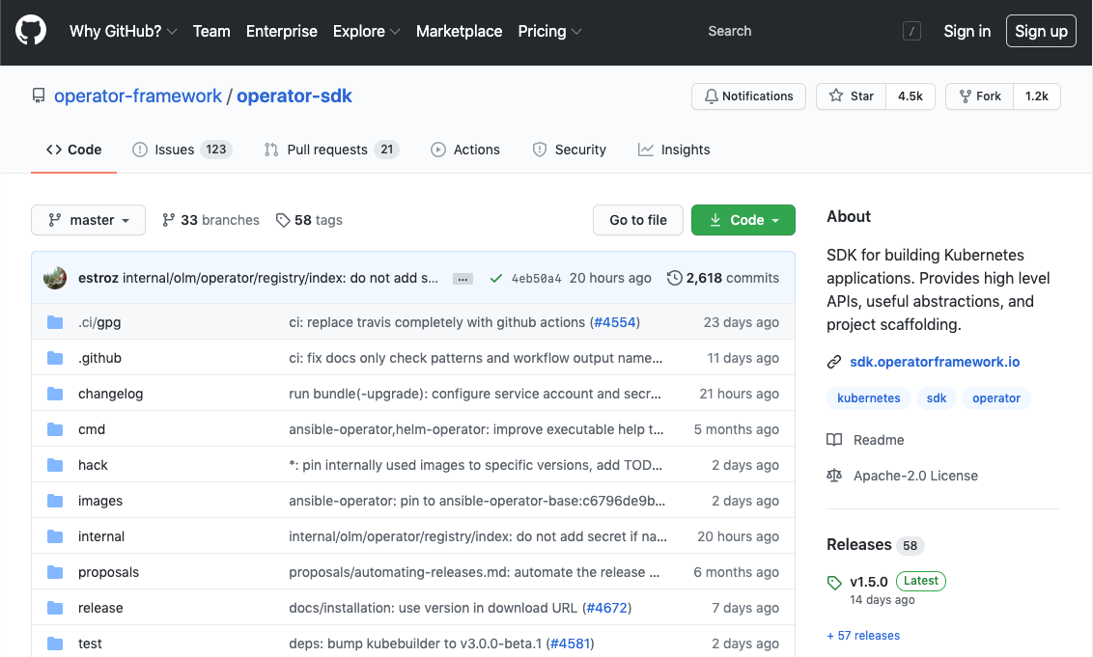
Getting OperatorSDK
https://github.com/operator-framework/operator-sdk
The operator-sdk binary is cross-compiled and supports various platforms and architectures (see releases for a full list)
Notes:
so we'll talk about using the operator sdk here if you want to get the operators case you're not familiar with it as some of you are we're doing some review if you're not familiar with it then great it's available on GitHub under the organization operator framework there's the URL but of course it's googleable for one and then of course we'll get these slides too once they've been cleaned up a little bit and we'll get a PDF that will have these links but it is available for download on GitHub and also it supports various platforms and architectures right if you go look at the releases they'll have all the various ones there and it is just a binary that you call right

Slide 11
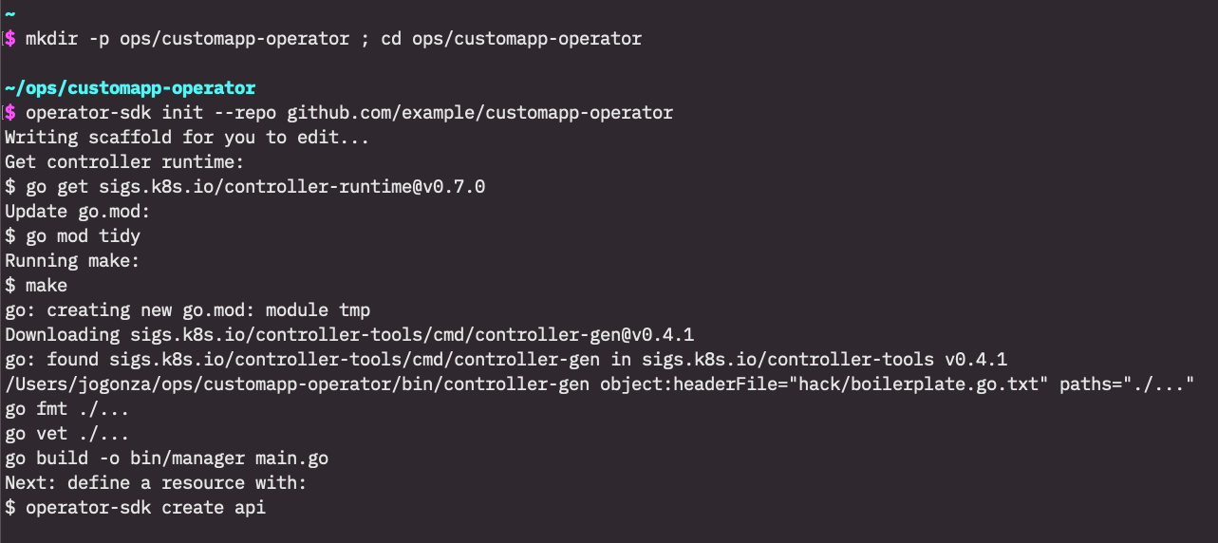
Scaffold a new project in two commands
And one is, arguably, optional.
mkdir -p ops/customapp-operator ; cd ops/customapp-operator
operator-sdk init --repo github.com/example/customapp-operator
Maybe it’s three commands in two lines… =)
Notes:
to get started scaffolding project right I'm going to say that it's basically two commands all what's displayed here on screen the text may be a little small but effectively what I do with the beginning is I just make a directory right and I go change directory into that one that I just made and then I will run the operator SDK binary right I'll run it with the init command and I'll specify some flags so in this particular case when you get these slides I have those commands down at the very bottom as well that should be copy pasted well because what's on screen is an image but you see that I've specified just a few flags there and I'm probably missing a few flags for what I would want my international project but at the very at its very core I'm specifying just a repo right in other words in other words what GitHub path what importable path and going I'm going to be using and then it goes and lays down a bunch of files and will look at those files are here in just to suck I do want to mention that right now what I'm showing you is creating an operator project in go length right we've talked about how operator SDK or maybe we haven't I'll mention now in case we haven't but operators DK does allow you to write an operator project in health and it will change the way you initialize your project and also lets you do so in ansible and again it changes the way you initialize your project and what those do I'm not going to show it here but what those do is that they allow you to use existing ansible roles or playbooks or existing helm charts to affectively build an operator project or in other words a controller that runs in your cluster and it effectively is a task runner so those are running ansible commands or ansible playbook commands or the helm commands to initiate your charts or playbooks based on variables that exist in a custom resource definition so it's a way of bridging the gap if you've got existing work already done in ansible Anne helm it is an easy way to really kind of get an operator project into a cluster an operator service that way and also get it available as a custom resource definition so that your users don't have to go download your helm charts and then template out some variables they can just do what they already know right they go and do cube CTL apply with the manifest that looks looks like your project and then this helmet ansible runner will get it done for you the go link project does give you more flexibility it's what we're covering here and I do believe rose will do the next couple of sessions which should cover some of those other use cases as well

Slide 12
$ tree
.
├── Dockerfile
├── Makefile
├── PROJECT
├── bin
│ ├── controller-gen
│ └── manager
├── config
│ ├── certmanager
...
│ ├── default
...
│ ├── manager
...
│ ├── prometheus
...
│ ├── rbac
...
│ └── scorecard
...
├── go.mod
├── go.sum
├── hack
│ └── boilerplate.go.txt
└── main.go
11 directories, 32 files
What was scaffolded?
A lot of boilerplate and tooling
Makefile
main.go (controller-manager)
PROJECT file (metadata for operator-sdk)
Dockerfile (for building a container image calling your operator
We’re still missing most of our controller logic and API code.
Notes:
dockerfile why do we need a dockerfile well our controller is going to run in a container in our Kubernetes cluster as a deployment just as we saw the etcd operator run and so we need that dockerfile
boilerplate makefile that is based on some of the parameters you provide in the way this project ends up getting laid out will give you easy access to things like controller-gen which we talked about before right you just run make and makefile target and it will it'll call controller-gen or maybe kustomize heavy use of the kustomize tool here as well all of those things live in that makefile
there's that project file there from the top down we're on the right side where we're going from the top town that project file is just metadata for operator SDK so you don't really have to worry or concern yourself too much about it but it will get updated periodically and if you have any issues it'll be quite clear that it's the project file that's causing it I believe the error messages are pretty clear indicating that there's an issue there if there is but generally you don't have to modify that by hand and then a bin folder that we don't really care too much about right now but effectively it has your controller manager in other words this project and then also the controller Gen binary right that's getting installed for you because you have to call it frequently there's this config directory that has a lot of customized customizing things if you're familiar with kubebuilder this should look very familiar 'cause operator SDK and kubebuilder affectively call the same logic right there kind of collapsed down and kind of aligned in how they work with operators decay just offering some additional functionality relevant to building operators that are old and friendly and so they're very they're very aligned in the way they work and so this config directory is kind of an artifact from the CU project itself contains a bunch of customized bases that are used to kind of render out your final assets you've got some go module things that were not really super worried about right now with related related to package versions that we're using in this in this particular project hack directory that contains just the text file it's just a license TXT file boilerplate that gets added to certain things and then your main dot go so if you look at this project here they may not goes not super important right now but if you look at this project we're missing a lot of code we've only got may not go right I've promised you more things or at least operator SDK has so we'll take a look at what that looks like now

Slide 13
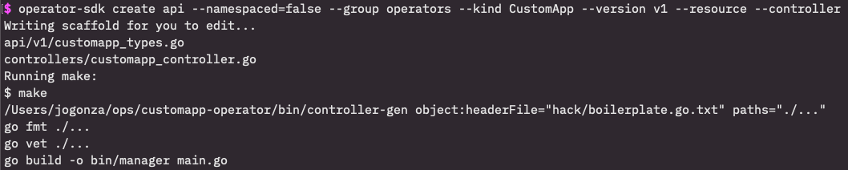
Creating our API
operator-sdk create api --namespaced=false --resource --controller group operators --kind CustomApp --version v1
Notes:
so clearly we don't have any API definitions until now so we'll run this command operate operator SDK create API will pass some flags right here we're creating the custom app to keep in alignment with our example but we're doing namespace set to false 'cause our scope for the custom app is cluster scopes right this is what was asked earlier it is a cluster scoped resource only one given name instance with the given name can exist in the cluster we can't have two Jose custom maps in this cluster and then we define the other identifiable parameters remember we need a group it's part of the resource right the slash APIs slash group and so we're going to find the group here operators which is I believe it's aligned with what was previous we've got the kind here declaration it's entitled case as well custom app and we've got our version remember it's a very stable application that we're using for our demo so it's version B one out of the box and then we pass a resource in controller flag and all that's really saying is generate both the resource code and the controller code for me right if you don't pass those in no big deal it will ask you yes or no do you want to create those things and then we see some log output right and you see you know API V1 custom map types go that got created for me the controllers directory with the file custom up controller dot got created for me that's awesome and then that's all it wrote and then it ran a make at the very top level to do some extra things make sure that we're formatting things correctly and building our manager which as of right now does nothing right no big deal there we don't really care too much about the makefile that's called

Slide 14
APIs and Controllers are Scaffolded with Placeholders
APIs
Controllers
$ tree api
api
└── v1
├── customapp_types.go
├── groupversion_info.go
└── zz_generated.deepcopy.go
$ tree controllers/
controllers/
├── customapp_controller.go
└── suite_test.go
Notes:
and if you take a look at these in from a tree perspective memory created that API directory B1 created a custom map types go it actually created some other things as well right that group version information or info go and then as easy file generated deep copy which I don't want you to worry about too much right now I think will cover it more later and then in the controllers directory as well you see that we actually have that custom app controller dot go that was generated for us and then a sweet test and this is for running test suites against your controller I believe it scaffolds by default test suites using ginkgo and Omega which are testing libraries in assertion libraries that are available for the go language

Slide 15
APIs and Controllers are Scaffolded with Placeholders
APIs
Controllers
$ tree api
api
└── v1
├── customapp_types.go
├── groupversion_info.go
└── zz_generated.deepcopy.go
$ tree controllers/
controllers/
├── customapp_controller.go
└── suite_test.go
edit these!
Notes:
and so you had these on your disk what would you edit well you're going to edit for the most part just those two files right that custom app types go that custom app controller dot go effectively if you don't want to you don't have to edit anything else right you will run some makefile targets to generate some things not a big deal there and then obviously if you want to write some tests you'll edit that sweet test or maybe you had some other tests in your directory but as far as getting your operating logic written you're going to work with these two files and you're now in your go directory in your project directory

Slide 16
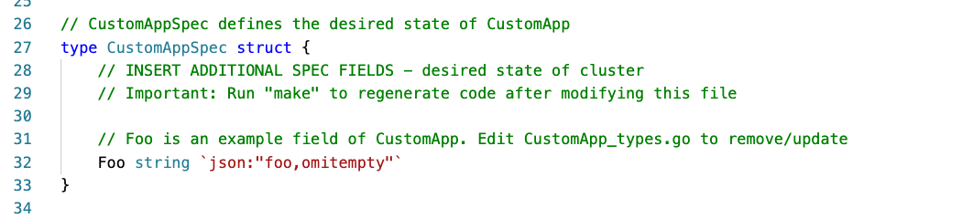
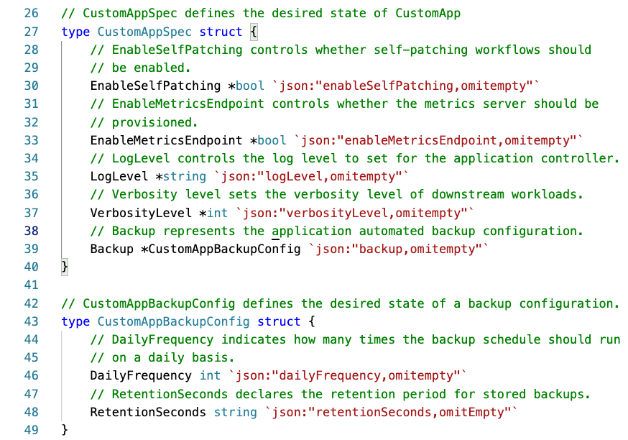
Editing the API scaffolding
api/v1/customapp_types.go
Going from the scaffold to your defined API.
Notes:
And so I think we're going to look at the API first remember align of the text is small on the screen it's just screenshots here but remember in an earlier session I showed that we took the custom app spec and we changed it from that that boiler boiler plate that we get initially on the left side that Foo key with the string type and you know that's just nothing right it's just templating for us and we changed it to what's on the right right all of these parameters that were available in that one manifest that we defined much earlier and that's where we did that we did that in the API directory that was scaffolded for us the V1 'cause we defined that version version one and in that custom app_type go file right it had everything that we needed as well as all those markers that were there previously to indicate that custom app is a Kubernetes object and needs to be generated using controllers and all of that exists in that custom app types go and now that i've made those changes let's say that i have this project structure here where i had the left side and i've now made all those changes to make it look like the right side

Slide 17
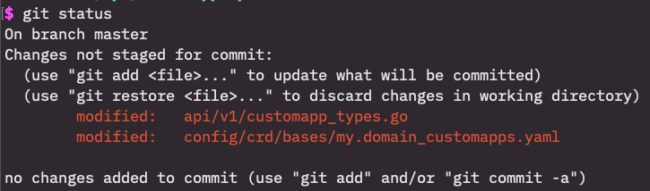
Changes to the API means we need to regenerate some things
Changes to our type definition(s) requires that we call make manifests.
CustomApp
CustomAppSpec
CustomAppStatus
CustomAppList
Runs controller-gen generators to generate our CRDs (among other things, if applicable) based on our new inputs.
Notes:
we need to generate some things right we need to use these tools like controller Gen to generate some things and so the biggest thing that of course that I indicated earlier that gets changed is that custom resource definition and so will run a makefile that makefile target manifests and it's going to create all of these things right it's going to create based on these types that I've declared custom app custom app spec custom app status custom app list based on these type definitions that exist in that go code that I just showed you have only shown you a subset here custom app spec and custom app backup config but the rest also exists in that same file it will run controller Gen generators to generate the CRD right we've changed the inputs now initially with that Foo key it existed there was a CRD on disk saying that we had a foo but now we have different keys in there and so we're running controller genta output in UCR dies and you see on the right side a git diff I'm a big fan of using git diff when running a lot of these generators it helps you see exactly what's changing and so you see we actually changed our API V1 custom map types go that was things that was code change that we put in place and then the generator that manifests target I believe changed the bottom one right and you'll see there's a slight differentiation there I have my domain that's screenshot error on my side so don't focus too much on the domain difference there as opposed to the example.com that we used in earlier slides

Slide 18
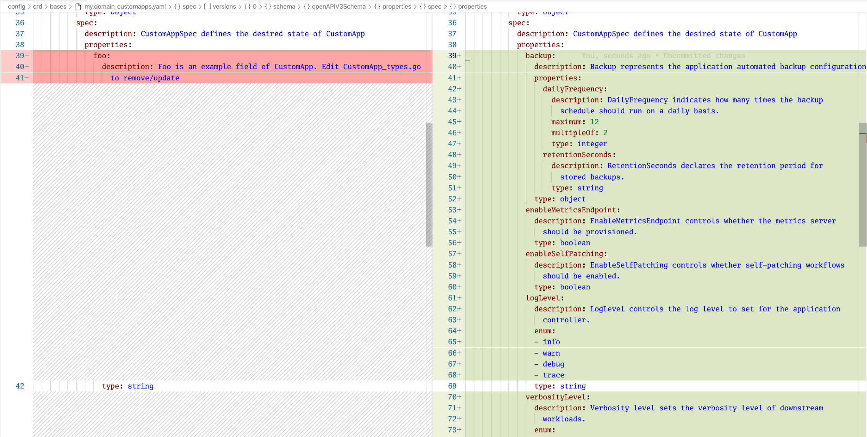
Notes:
and here's just another again a git diff text is a little bit small this is a quite a large screen screenshot but you see the change right I just ranted git diff on the CRD after we ran the makefile target manifests and it resulted in this change right the fu on the left side is what we get scaffolded out of out of the box with that type string and then get of course tries to save that type string 'cause inevitably we used it somewhere else but the rest gets replaced with everything else that's relevant to us and this looks exactly like what I showed you earlier with regards to those validations in there for the enumerations you see that on the right side right here around line 65 those enumeration's were there so in effect I've included all of those things in write code changes

Slide 19
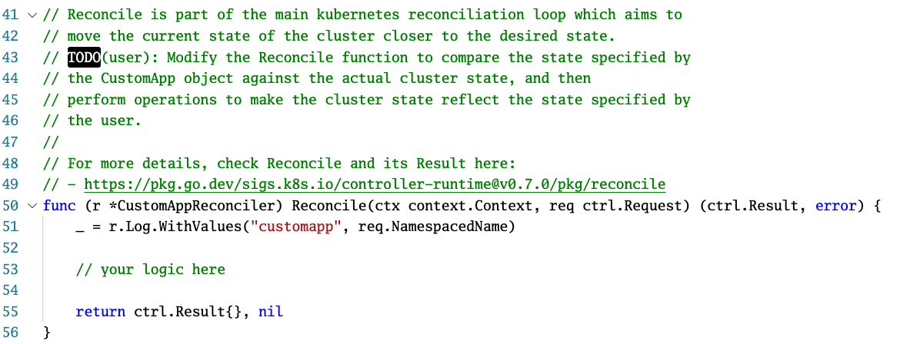
Editing the Controller Scaffolding (i.e. adding our business logic)
controllers/customapp_controllers.go
Going from the scaffold to your defined API.
Notes:
that has been all about the API let's take a quick look at the controller the controller code again I I mentioned that in that controllers directory there's that custom map_controller down go and we are adding our business logic here now if you knew nothing else about this project other than you know kind of understood hey there's a reconciliation flow that we have to we have to go change you know and we've already got the APIs defined and we're going to change some logic in our in our controller this is the file that you would edit and this is what it looks like out of the box right it's got placeholder things you see that comment online 53 saying your logic here there's nothing going on right now right this is the scaffold and stuff we don't want to change things for you on your behalf so we're going to leave it scaffolding and then of course excuse me the to do at the very top is just stuff that's indicating to us as developers or the users of this project of operator SDK we need to change

Slide 20
Reconciliation
(simplified pseudo-code)
func (r *CustomAppReconciler) Reconcile(ctx context.Context, req ctrl.Request) (ctrl.Result, error) {
// simplified
l := r.Log.WithValues("customapp", req.NamespacedName)
l.Info("getting desired state of CustomApp from the API")
desired, err := r.getDesiredCustomAppStateFromTheAPI(req)
if err != nil {
return ctrl.Result{}, err
}
l.Info("determining which owned resources need updates")
resourcesToUpdate, err := r.determineStateOfManagedResources(desired)
if err != nil {
return ctrl.Result{}, err
}
l.Info("performing updates to owned resources")
if err := r.updateManagedResourcesToDesiredstate(resourcesToUpdate); err != nil {
return ctrl.Result{}, err
}
l.Info("updating CustomApp status to reflect new changes")
if err := r.updatedStatusOfCustomApp(desired); err != nil {
return ctrl.Result{}, err
}
return ctrl.Result{}, nil
}
Notes:
and then in the next slide here you'll see this is a little small as well but you see this is what happens now right like I've just this is pseudocode quite simplified but effectively I'm doing in this reconcile function a bunch of things that are going to change the desired state I'm sorry the existing state to make it match the user's desired state the user has created a custom app it is my controller's responsibility to go make it so right make it look correct according to all downstream managed resources and so this function is effectively what gets called whenever an event gets triggered so in other words a user did a kubectl or an oc apply dash F and they passed in a file that contained a manifest for a custom app exactly as we exactly as we defined it earlier in other words exactly is our custom resource definition defines it

Slide 21
Reconciliation
(simplified pseudo-code)
func (r *CustomAppReconciler) Reconcile(ctx context.Context, req ctrl.Request) (ctrl.Result, error) {
// simplified
l := r.Log.WithValues("customapp", req.NamespacedName)
l.Info("getting desired state of CustomApp from the API")
desired, err := r.getDesiredCustomAppStateFromTheAPI(req)
if err != nil {
return ctrl.Result{}, err
}
l.Info("determining which owned resources need updates")
resourcesToUpdate, err := r.determineStateOfManagedResources(desired)
if err != nil {
return ctrl.Result{}, err
}
l.Info("performing updates to owned resources")
if err := r.updateManagedResourcesToDesiredstate(resourcesToUpdate); err != nil {
return ctrl.Result{}, err
}
l.Info("updating CustomApp status to reflect new changes")
if err := r.updatedStatusOfCustomApp(desired); err != nil {
return ctrl.Result{}, err
}
return ctrl.Result{}, nil
}
Read State from API
Parse Desired State
Reconcile current state
Make current state observable
Notes:
and this is the logic that gets called and so you see you know I'm doing a couple of things here I'm reading the state from the API right I'm reading the desired state from the API why am I doing that well because I don't know when I call this function what changed all I know is that something changed and my reconciliation logic needs to be aware that it does not know what changed it needs to go determine how it needs to make changes to make things a correct so it needs to go and pull from the API using the clients notice that I've not set up any clients here right I have not done any client setup but it has built in clients here that are laid down for you using that reconciler type that then allows me to go and query the API for the current state of the object that has changed so the next item there the second second bracket is parsing that desired state right I went ahead and got the desired state now I need to parse the desired state to determine what I need to do to make a change right and then that third bracket of course I make a change and then that 4th bracket is going to help the state the status rather of my custom resource right that custom app instance that was created by the user I'm going to update it to say hey you know status deployed or you know you know here the downstream resources that are whatever is useful to the user and I decide that I decide that as the operator author what is useful to the end user in terms of this state

Slide 22
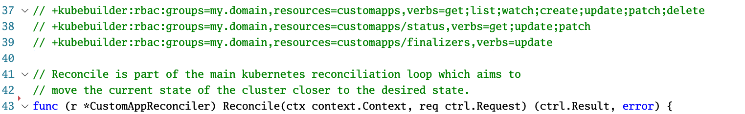
Adjusting RBAC
My core business logic needs to be able to interact with ________!
E.g. Deployments, Statefulsets, PersistentVolumeClaims, etc.
source: controllers/customapp_controller.go
Notes:
So we talked about how my my client already exists member I didn't have to create a client there is a client that's laid down for me right so we talked about how my client needs to be able to interact with PPI at the very least to get my custom map resource I need to get the instance I will get information identifying exactly what instance of that custom resource changed so for example this is a cluster scope resource I know that if a user goes and creates the Jose dash custom app and it is an instance of a custom app I will know in this reconciliation logic that it was the Jose dash custom app that changed and then I will go operate based on that information and so that means at the very least that I need to interact with the Kubernetes API to get that custom app that specific one called Jose dash custom app I need to go and get that from the API which means that I must have as a service running in the cluster a service account must have RBAC I must have a proper set of permissions allowing me to go get that from the API and so here we see this concept of markers that we talked about earlier right at the align 3738 and 39 you read those and it's you know again starting with that + that says Q builder and the generator that we're talking about here is the RBAC generator and I'll explain what that means here in a second and we have the group is my domain again that's a discrepancy in the screenshot it should be example.com or whatever the case may be maybe your application website.com and then the resource that I'm allowing permissions to right so in this case it's custom apps and then the verbs that I want to allow you see that; Separated list of things there get list watch create update passion delete and then we have some additional ones we've status is the status subresource in the finalizer subresource that we're not super concerned about but understand that I've indicated to these markers I have indicated that each of these is our back that I need to have access to as this service account running this reconciler and so I can put it right next to my code exactly what permissions I need

Slide 23
Adjusting RBAC
My core business logic needs to be able to interact with ________!
E.g. Deployments, Statefulsets, PersistentVolumeClaims, etc.
source: controllers/customapp_controller.go
Then run: make manifests
The RBAC manifest for this controller to run gets generated into the config/rbac directory
Notes:
and then we will use we will use a tool controller-gen that we've talked about earlier to take those that are circled now and turn them into a role or cluster role depending on what I need right it'll it'll it'll call controller Gen when I run make manifests controller Jim will then read this because again that make manifest command is already targeting the right code because operators DK his scaffold it in this standard way and controller jenn will then generate a proper set of our back that is a role or a cluster role in a role binding or cluster role binding and put that on disk for me so that I can then give that to an administrator or a system like om to then go and create that for me before my operator is installed or as I'm installing my operator and so we can expand that we see only these three here but we could expand that to other resources so for example we know that the groups for deployments apps and so we could add another line here saying I need access to deployments great so let's do plus que builder: RBAC: groups equals apps and then resources equals deployments and then the verbs so let's say I only need to redeployments well OK fine then I only need get list in watch or maybe I only get listen watch or whatever the case may be saying need to create deployments OK well now I need the CD right create update and patch and then finally if I need to delete a deployment well I need to add that as well and I can do that for any other resource that's available in the cluster

Slide 24
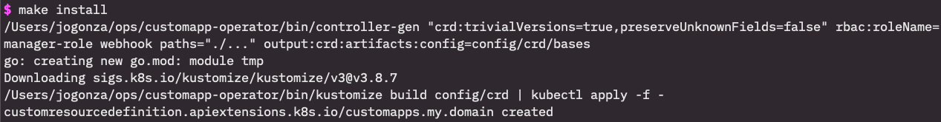
Running the operator during development
Install your Custom Resource Definitions
Notes:
moving right along again running short on time here and over 15 minutes till the end of the session I'm trying to get through all the slides if I want to run out loud for questions at the very end if I want to run if I want to run the operator during development it would be somewhat frustrating if I needed to then build a container every single time push it to a container registry and then make that available in the cluster so go run a deployment manifest and all this kind of stuff that would be quite a bit of lead time or at least a bit of overhead

Slide 25
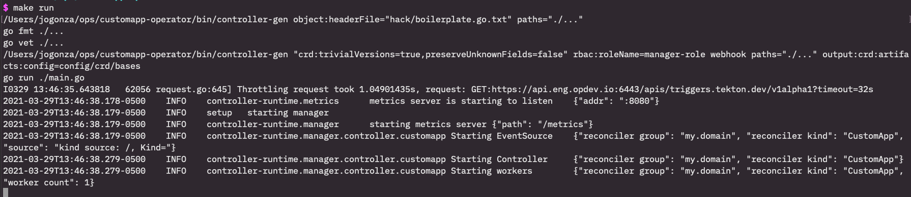
Running the operator during development
Run the controller
Running your controller using make run effectively runs this as your current-context value in KUBECONFIG.
Notes:
then you'll make run and make run is another target that just runs your binary on disc and it uses your kube config that is in your current context so if you have queue config in the_excuse me the doc I forget the path now but it's dot cube slash config or whatever case maybe or if you exported the cube config environment variable and you set it to a file on disk or whatever the case may be it's going to use that context to run this controller so the permissions there need to be correct in order for this work we're not using any of the generated are back in this particular case 'cause we're running it just from your machine not in the cluster just from your machine and so this is more development tool just want to make you aware that you can make run to run the controller on disk as it's it's so you don't have to go and package it up send it to container registry and then make it available

Slide 26
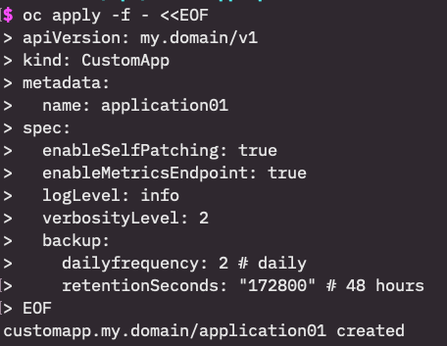
Running the operator during development
Create an instance
Running your controller using make run effectively runs this as your current-context value in KUBECONFIG.
Notes:
once that's running you have to have a different terminal open and again just do an OC apply of your custom map here I've adjusted the screenshot to take into account the my dot domain here but effectively this is the exact same resource that we made earlier right and so this is the V1 instance of it and we're creating it

Slide 27
Running the operator during development
The controller responds!
Running your controller using make run effectively runs this as your current-context value in KUBECONFIG.
Notes:
then you would expect your reconciler to then as I showed with argosy D start doing things right here's log output from the current state of operator SDK I think the argosy used an earlier version of our of operator SDK so current version logging does look like this and so you see that it did all the things if you looked at the pseudocode nice and closely which of course as pseudocode I don't really expect you to do these are the exact same log lines right now I just scaffold it a bunch of placeholder functions to make it so that this runs in this way and kind of give you some continuity with the examples that I've shown so far but look at what's happening right we're getting the desired state the custom app from the API and it shows which one right I created the application 01 you see on the right side that we're talking specifically about application 01 that is the instance I created if you look right here right that name application 01 and then it determines which owned resources need update so let's say that custom app manage is the reconciler manage deployments in pods or the case maybe well it's got to determine which of those own resource needs updates based on the current state of application to one and then it's got to be formed those updates and then finally it's got to reflect those changes in the status block right so this is just a bunch of pseudo code or kind of example of what it looks like running a controller that is managing this resource

Slide 28
Running the operator during development
The controller responds!
That’s how fast we can go from nothing to an installable operator that’s doing some initial work for us using the OperatorSDK
Less time spent on codifying informers and caches, controller managers, clients, initial type declarations, various manifests, etc.
Running your controller using make run effectively runs this as your current-context value in KUBECONFIG.
Notes:
so you know it's kind of summarizing that particular section that's how fast we can go from having nothing on disk that is operating a that is that is responding to customer resources in a given cluster in other words we've extended the API we've wrote some we've written some business logic in our controller and that's how fast we went from being able to do absolutely nothing against the Cuban API without having to use cube CTL commands potentially in bash script it's to getting closer to making this same application available the service right we don't spend a lot of time writing the code for the informers in the caches it's important those things because those are key components of controller development but operators KQ builder and a lot of these projects and even controller runtime underneath they're giving you things to facilitate that right you don't have to worry so much about the fact that you need to be using an informer Anna cash setup so that you're not pounding the communities API too aggressively an inevitably bring it down right you don't have to worry so much about the concept of controller manager right we haven't really talked about controller manager here we just talked about your business logic right we haven't set up any clients right Melvin talked a lot about client go we haven't had to set up those things right because those things are kind of pre scaffolded for us how we interact with the API is scaffolded for us using operator SDK and will talk will look a little bit more closely at some of those how those clients are actually used in the later sessions I believe align this is and then finally sorry was there question no question OK and then the initial type declarations and you know that we added the the keys and values in our type structure type definitions but the initial declaration how that's laid out right how do we go about you know we don't really talk about how we fulfill the interface is required for any Kubernetes type yet and that's all done for us for the most part we just have to go in outdent are structs to make it more true to our use case and then generating various manifests we haven't had the generator we haven't had to hand write a Kubernetes manifest yet for the controller custom resource definition the RBAC etc etc

Slide 29
More APIs, Controllers, and Webhooks
You can continue to create additional APIs as you need - operator-sdk will scaffold the initial API definitions and controllers for you.
operator-sdk create api --kind ${KIND} --version ${VERSION} --controller --resource …
You can also scaffold a webhook (defaulting, conversion, validating, etc):
operator-sdk create webhook --kind ${KIND} --version ${VERSION} --conversion --defaulting ...
Notes:
and so if you want to go and do more APIs we've only talked about one right we've talked about the custom app but say my operator this particular operator that I'm working with has five different controllers as an example that make up the operator maybe I need logic for that backup component and I need separate logic for that or maybe I need logic for managing maybe I have some scheduling that needs to happen or any have something that's talking to an external system and I want to make those available as separate controllers the end user may not know about these things existing but I have the ability to go and separate that logic out to make my logic more readable and much more self contained and so I can just create additional APIs if I want to or I can just create additional controllers I don't have to create an additional API with the excuse me I don't have create an additional custom resource I could just create additional controllers that operate on the same resource now I'll tell you that things that they need they need to have different scopes in other words those two separate controllers operating on the same resource should manage very different things to avoid collisions right we don't want them impacting the same sets of resources but it is possible right I can go ahead and scaffold an API that they are a controller with no reference to an API or even a controller or sorry it controller with go reference to to a brand new API I can have it impact a pot maybe it's washing pods maybe it's watching deployments maybe it's watching services whatever and then we talked about web it's a little bit earlier you can also scaffold some of that code as well we're using the operator state operator operator SDK create webhook command I've been talking too much today my apologies

Slide 30
Building and publishing your operator image
The included makefile has a target for creating your container image.
IMG=quay.io/your-namespace/my-operator:1.0.0 make docker-build
Then just push away!
IMG=quay.io/your-namespace/my-operator:1.0.0 make docker-push
You can update your makefile to have your image tag so that you can leave those bits out!
The docker-build makefile target will run test suites against your code before generating a container image.
Notes:
and so once you're done with your project you do need to make it available publicly right or in a way that's consumable and accessible by a cluster when they go and pull your image into the cluster and so there are included makefile targets for pushing and building these things and so it for your operator image you just run a make docker build and I've specified a key on the left side an image environment variable or variable in general and I've said you know what my Cle Dino or Mikey dot IO namespaces and then the name of my operator and the version all these kinds of things and then I just stop push right it's really no different than running a docker pleasure padman push and then putting the same variables on the right side in theory you can go ahead and update your makefile so that you don't have to put those details in and so for your given operator project that maybe that key dot IO namespace is going to be the same across across your work with that project that operator and so you can just code those into your makefile so you don't have to include the left side and then once you do a couple of more concepts here so that's that's for your given operator right that's a given application that's your controller logic it is the R go CD operator deployment manifest

Slide 31
Building and publishing an operator release
A “bundle” is a collection of metadata for a given “release version” of your operator. This includes the visual cues for how your operator shows up in the Openshift UI, as well as things like RBAC to assign toy our operator deployment. Used for shipping your operator in a cluster with Operator Lifecycle Manager running.
Bundles are packaged as non-runnable container images and live in container registries, created like :
BUNDLE_IMG=quay.io/your-namespace/my-operator-bundle:1.0.0 make bundle
This step takes care of making necessary bundle assets and organizing a bundle directory for you.
Then build the container image and publish!
BUNDLE_IMG=quay.io/your-namespace/my-operator-bundle:1.0.0 make bundle-build
docker push quay.io/your-namespace/my-operator-bundle
Notes:
we looked at what you're publishing here but there's also this concept of a bundle right this bundle is a given release of your operator right and so you say that OK cool my controller is at version V1 and I'm going to release a bunch of metadata around that right such as the name that it shows that we should be looked at the open shift console the operator lifecycle manager in the embedded operator hub a lot of that metadata comes into play right here right we're going to build this bundle this concept of a bundle and will look at that more closely later as well but this concept of a bundle that encompasses all of the metadata associated with that given release version of your operator right so if it's a one dot O .0 release I expect to have a bundle that I am building for the one data release that includes all the metadata associated and that metadata by the way includes all of that our back that we generated right that deployment manifest that we generated and it includes those using this resource called a cluster service version I know Melvin as mentioned that in the previous sessions and will look at that more closely later as well I believe in the OEM section but it is a bunch of metadata encapsulated without particularly release then why is that important well if I go from one dot O .0 to two dot O .0 maybe my RBAC is different maybe I no longer need to manage deployments maybe I'm managing pods directly well I no longer need that are back and so it's important to be able to say in one that I have the are back included in this metadata this directory structure with metadata in it that includes the ability to crud create read update delete deployments but maybe in the 2.0 I don't need that and so that's why we have this idea of a bundle that encapsulates all of that information for a given release of your operator and then as far as building it there are makefile targets for that as well we have a make bundle command and we again it's a different path excuse me it's a different path for your for your artifact that's build here it's all that all of that metadata is encapsulated in the container and push to registry and then you can make the bundle on your disk first it's the top command make bundle that will give you a directory structure that is generated and it will party or it will ping you for some questions as well as far as how that metadata should look and then create that directory structure and all the assets all M needs in this particular case and then you push that to a container registry you build the image on your disk and then you push that to container registry at the bottom

Slide 32
Running in a cluster
The operator-sdk command facilitates testing that bundle that you’ve built and published:
operator-sdk run bundle quay.io/your-namespace/my-operator-bundle:1.0.0
In a traditional scenario, you’ll include your collections of bundles (i.e. your operator versions over time) in an “index”, which is like a repository of operators made available in OpenShift (and OLM-enabled Kubernetes) clusters.
Notes:
and so we have this idea of a we have this idea of the bundle and so in order for you to run the bundle in your cluster you can do an operator SDK run bundle it's just a hook that basically operator SDK makes available so that you can run from that bundle in the container registry such that when it gets added to this idea of an index or a almost like a repository of bundles of different operator bundles you know what it looks like as it's pushed in the public asset versus what it looks like on your disk because you want to make sure that you want to get close to the user end users experience here

Slide 33
A brief tour of controller-runtime

Slide 34
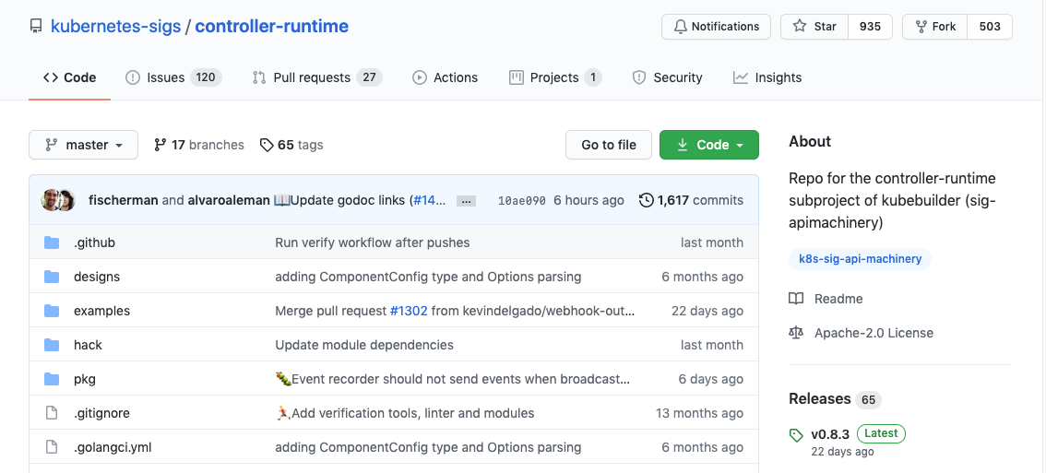
The controller-runtime library is at the core of OperatorSDK
OperatorSDK is able to provide so much value by taking advantage of the work of the APIMachinery/Kubebuilder special interest group.
Notes:
we're going to try to burn through these slides here we've got we've got a minute and not suffice to say the controller runtime itself is at the core of operator SDK controller runtime is coming from API machinery upstream and cue builder the project it's basically a library that's available from the special interest groups close to Cooper netease and they make it available to the public to help them right controllers right and that's the controllers quarter operator development

Slide 35
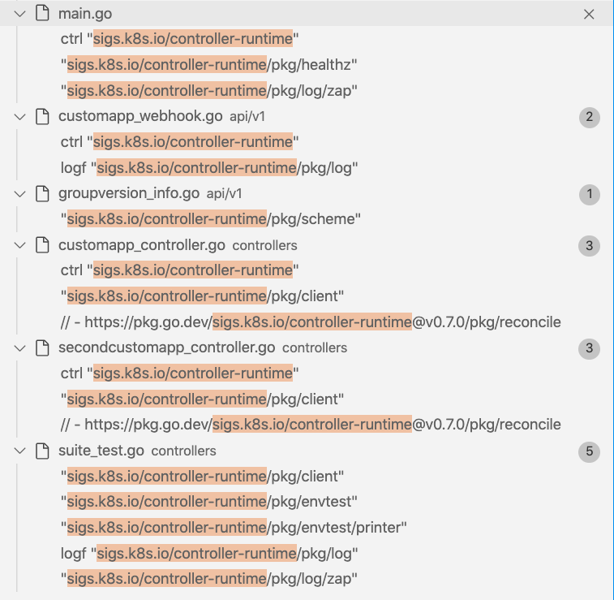
The controller-runtime library is at the core of OperatorSDK
Notes:
and so if you look at a given project right you'll see a lot of things such as this is just me doing in my code editor VS code I did a global search for the import path controller runtime you see it's in a lot of places but most importantly there's a webhook that have scaffolded there there's a controller that scaffolding you see various packages here being exposed interfaces that they want you to be able to use being imported so that's great and then also of course in our testing it's all over our testing right you see that very last file suite tests

Slide 36
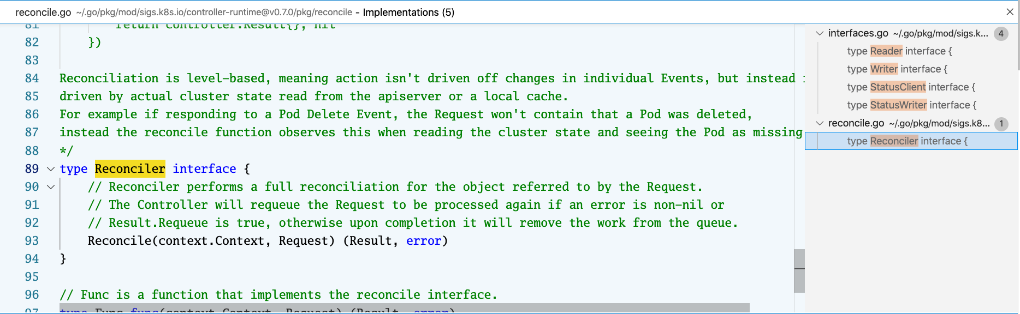
Implementing Interfaces defined in controller-runtime
This is the “Go to Implementations” function of VSCode when called on a <Type>Reconciler as defined by OperatorSDK/Kubebuilder.
Notes:
so here you know if we take a look at the particular codebase right I've gone to my custom app I've got my custom app struct and in GO terms and I've gone and said hey what implementations does does this custom app implement right and so you see excuse me I said my custom app what I meant was my custom app reconciler and I looked to see what implementations it implements in other words what interfaces it implements and so we see right away oh we're implementing this reconciler interface that is made available again or defining control runtime and then also on the right side you see all of those readers and writers right status client status writers these are all things that the custom app reconciler that's been scaffolded by operator SDK that they all implement and it's done for us right we don't really have to worry about it but these interfaces are defined by controller runtime and the I do see a hand raise I will get I will get to get to question at the very end just so I can make sure we get this I know I want to be respectful of everybody's time and make sure if you need to drop that you don't miss anything this is recorded as well so if you do happen to miss the end will get these recordings to you

Slide 37
Writing to the API
// Writer knows how to create, delete, and update Kubernetes objects.
type Writer interface {
// Create saves the object obj in the Kubernetes cluster.
Create(ctx context.Context, obj Object, opts ...CreateOption) error
// Delete deletes the given obj from Kubernetes cluster.
Delete(ctx context.Context, obj Object, opts ...DeleteOption) error
// Update updates the given obj in the Kubernetes cluster. obj must be a
// struct pointer so that obj can be updated with the content returned by the Server.
Update(ctx context.Context, obj Object, opts ...UpdateOption) error
// Patch patches the given obj in the Kubernetes cluster. obj must be a
// struct pointer so that obj can be updated with the content returned by the Server.
Patch(ctx context.Context, obj Object, patch Patch, opts ...PatchOption) error
// DeleteAllOf deletes all objects of the given type matching the given options.
DeleteAllOf(ctx context.Context, obj Object, opts ...DeleteAllOfOption) error
}
Notes:
at the very end here on this slide rather we have that writer interface that we saw is being implemented here and it's the create delete update patch and delete all of right these are all the right actions that are necessary or that you have access to when you are interacting with API that's implemented for us we know that for effect

Slide 38
Reading from the API
// Reader knows how to read and list Kubernetes objects.
type Reader interface {
// Get retrieves an obj for the given object key from the Kubernetes Cluster.
// obj must be a struct pointer so that obj can be updated with the response
// returned by the Server.
Get(ctx context.Context, key ObjectKey, obj Object) error
// List retrieves list of objects for a given namespace and list options. On a
// successful call, Items field in the list will be populated with the
// result returned from the server.
List(ctx context.Context, list ObjectList, opts ...ListOption) error
}
Notes:
and the reader as well and these are not functions that exist in our code we just know that this exists as something that we implement that's probably coming from us borrowing from controller runtime when we lay down this operator SDK project so suffice to say that controller runtime is providing a lot of value here

Slide 39
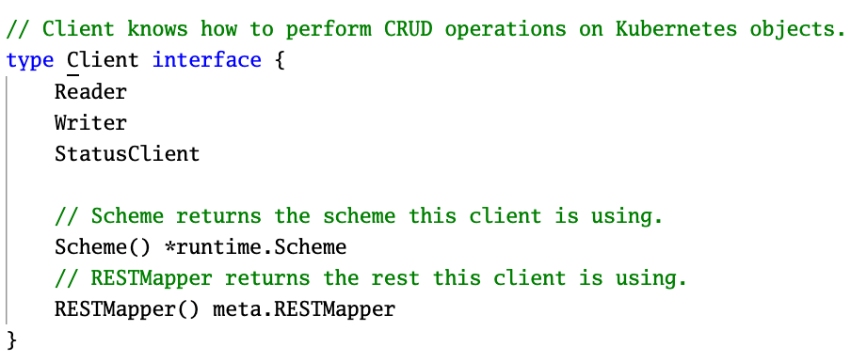
I don’t see the Reader and Writer interface methods in my code!
How does our Reconciler implement these interfaces?
source: customapp_controller.go
// CustomAppReconciler reconciles a CustomApp object
type CustomAppReconciler struct {
client.Client
Log logr.Logger
Scheme *runtime.Scheme
}
Embedded Interface
source: sigs.k8s.io/controller-runtime
Developers must pass in a concrete definition of a client.Client when creating a CustomAppReconciler type.
Notes:
and so that's kind of what I'm pointing out here right we don't see the reader and writer interface methods in our code if we scaffold project today a go link project today we won't see a read write and that matches all of those function signatures right all of these signatures right here the passing of context and provides it an object and then to create options we don't we don't define those but we're embedding or rather operators decay has embedded for us a client and have set up when we set this up and run our code it is automatically giving us a client that we have access to that implements all of these interfaces which is great so these are things that we don't really have to worry about out of the box unless we have something specific that we need to we need to work with us on

Slide 40
Our scaffolded main.go handles the creation of CustomAppReconciler
Let’s look at the main.go
Notes:
and so we were going to not go in the interest of time I'm going to go and skip that but we can we'll do some of this in the coming sessions when we actually do hands on in the code in an editor and I think rules will cover some of that

Slide 41
Controller-Runtime is the core of any operator project (in Go).
It’s a lot of very useful code that helps us prepare our controller projects for interacting with the Kubernetes API.
OperatorSDK (and Kubebuilder) takes advantage of the library to make scaffolding new projects very simple by using sane defaults.
Notes:
then so the key summary here is that the controller runtime is just core of any operator project it doesn't even if you write in go right control runtime is a library for going if you write in another language there are some libraries say Python or Java that also exists an obviously they not they may not be using controller runtime formally as it is just to go as the language of Kubernetes but there's a lot of useful code here I would recommend in any operator project you're writing operators go get familiar with controller runtime once you started you know getting a basic reconciler going and getting your basic project and go written go take advantage of a lot of that code that's there go read it and kind of see how they're doing some things and you'll learn even to this day I'm learning about different functionality that's exposed via controller runtime that I've maybe implemented myself in my own operator projects or had the question how am I supposed to do that and so controller runtime really is helpful in both operator SDK NQ builder kind of stand on the shoulders of control runtime to help do what they do

Slide 42
The End - A Tour of the OperatorSDK

